Slide 1
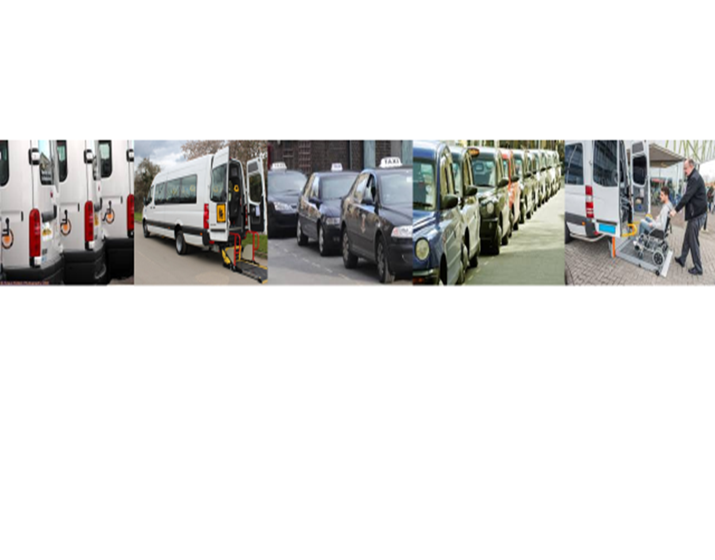
Assisted Transport Services
London Borough of Sutton and AfC (Royal Borough of Kingston and London Borough of Richmond )
Market Engagement Events
Notes:
Client to add branding to slides

Slide 2
Introduction
House keeping
What this presentation is going to cover
Introduction to project team and adam
Notes:
Fire alarms, exits, toilets, tea and coffee
Please keep questions to the end when there will be a chance to ask questions once you have heard from all of the speakers
Slides will be made available for you to view after the event together with copies of questions asked
Please ensure you have signed in so that we know of your interest.

Slide 3
Background
Procurement of routes across 3 boroughs
Includes transport to out of borough schools and other facilities
Includes routes with Passenger Assistants and wheelchair accessible vehicles
Vehicles ranging from cars to mini buses
Current spend across the 3 boroughs is approximately £9.5m per annum
Around 400 routes across the 3 boroughs
Notes:
Client to add branding to slides

Slide 4
Current Process
Framework Agreement consisting of 30 providers
Expires at the end of July 2019
Routes commissioned separately by Sutton and AfC transport teams
Individual invoicing
Notes:
Framework is limited to a fixed number of providers for 4 years
Does not allow new providers into the market
Routes will continue to be commissioned separately but all opportunities will be visible to all providers.
Currently each route is invoiced for separately and manually checked. This is a time consuming process.

Slide 5
Safeguarding
Safeguarding our passengers is vital
Drivers must hold UK licences for the vehicle they will be driving
Passenger Assistants & Drivers must both hold valid Disclosure & Barring Service (DBS) certificates
Crew members may be asked to attend Council offices for vetting and must complete safeguarding training prior to staff starting on a route
All crew members must be fully committed to delivering the service to the passengers

Slide 6
Why the opportunity?
Current Framework ends this summer
Want to continue working in partnership across 3 boroughs
Want to continue to work in partnership with local businesses
Continue to provide safe and high quality transport services for our vulnerable children and young people
Opportunity to make invoicing and payment simpler
Transparency and accountability in the process
Notes:
Client to add branding to slides

Slide 7
What is in it for you?
Access to approximately £9.5m per annum spend across 3 boroughs
Visibility of all routes
Opportunity to grow your business
Automated and efficient invoicing process with guaranteed payment for contract delivery
Open, simplified application process
Notes:
Client to add branding to slides

Slide 8
How?
Introduce adam (handover)

Slide 9
Digital Commissioning
for
Passenger Transport Services

Slide 10
Hello
we are adam – enabling individual wellbeing
Our Human Touch Technology ™ service connects individuals (and their advocates) - with professionals and a dynamic supply network to enable improved individual wellbeing
Notes:
Our main aim is to promote the wellbeing of the individual, but ensuring that they receive the best service possible, which meets their needs.

Slide 11
Terminology
Dynamic Purchasing System - Electronic procurement model
SProc.Net - the system used to manage the DPS.
adam – the company that owns the SProc.Net system.
Accreditation and Enrolment – Selection criteria required to be met to be approved on the DPS.
Supplier Agreement – Overarching Terms and Conditions.
Requirement – a route that needs to be delivered.
Offer – a Tender Response.
Service Agreement – a contract to deliver a route.
Service Receipt – the receipt/invoice for the delivery of the route.
Self Bill – System Generated Invoice.
Notes:
Before we start explaining what we do, its important to go through some of the terminology that we use…

Slide 12
SProc.Net
Requirement Creation and Distribution
Registration
Accreditation
Enrolment
Service Agreement
Contract Award
Offer
Review
Offer Submission
Service Receipting
Service Receipt Approval
Invoice and Self Bill
Payment

Slide 13
Becoming an Approved Provider
Registration
Accreditation
Enrolment
Company Details Provided
Documentation and Information submitted for review
Documentation and Information submitted for review

Slide 14
Becoming an Approved Provider
As part of the Accreditation and Enrolment process, you may be asked to provide and/ or accept the following:
Accreditation
Company Information
Self-Bill Agreement
Supplier Agreement
Declaration Statement
Enrolment
Mandatory Exclusion Questions
Discretionary Exclusion Questions
Economic and Financial Standing
Insurances and Quality Questions
Method Statement Questions
Contract Examples
Licensing Information

Slide 15
Submitting an Offer
Requirement Creation and Distribution
Offer
Review
Service Agreement
Offer Submission
Contract Award
Notes:
Requirement Creation and Distribution – LA sends out the request for a service
Offer Submission- Offer submitted
Offer Review- LA reviews submitted offers
Contract Award – LA chooses successful provider to deliver service
Service Agreement- Service Agreement/Contract is created and agreed by both parties

Slide 16
Billing
Service Receipting
Service Receipt Approval
Invoice and Self Bill
Payment
Weekly submission of work completed
Invoice and Self-Bill visible
Approval of funds within agreed tolerances
Payment sent out

Slide 17
Accreditation and Enrolment Demonstration

Slide 18
Next Steps
Register on Sproc.net from 13th May
Begin Accreditation and Enrolment from the 20th May 2019
Complete and Submit Accreditation and Enrolment by 17th June 2019
1st July Go Live: reprocurement exercise begins
Attend Drop In Sessions in early June
Attend full Sproc.net training on the 25th, 26th, 27th or 28th June
View all documentation and guides at demand.sproc.net

Slide 19
Help & Assistance
For any clarifications on the contracts, please email Sutton and AfC at procurement.contracts@Sutton.gov.uk
For queries regarding your Accreditation & Enrolment applications (A&E), please email adam at supplier.engagement@useadam.co.uk.
Alternatively, you can contact Chloe, your Onboarding Manager on 07850 913 121
For any technical queries or issues, please use the adam LIVE CHAT function on SProc.Net

Slide 20
Any Questions?

